Slide 1
Introduction to ERPs

Slide 2
Neuroscience methods
Hemodynamic
  Measures blood moving in brain
Electrophysiological
  Measures electrical signals from neurons

Slide 3
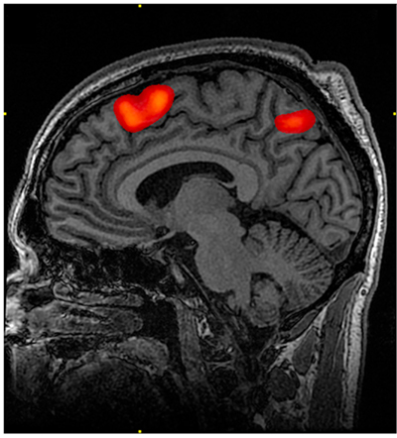
Hemodynamic methods
fMRI
PET
NIRS
Sensitive to location, not sensitive to timing

Slide 4
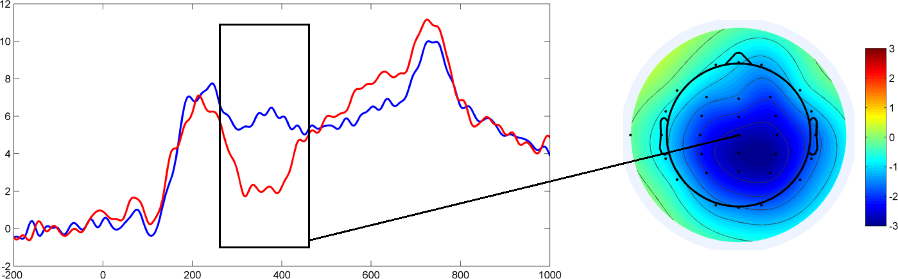
Electrophysiological methods
EEG
MEG
Sensitive to timing, not very sensitive to location

Slide 5
Why care about timing?
To know the brain activity at a specific word in a sentence
To know what process comes first when understanding language

Slide 6
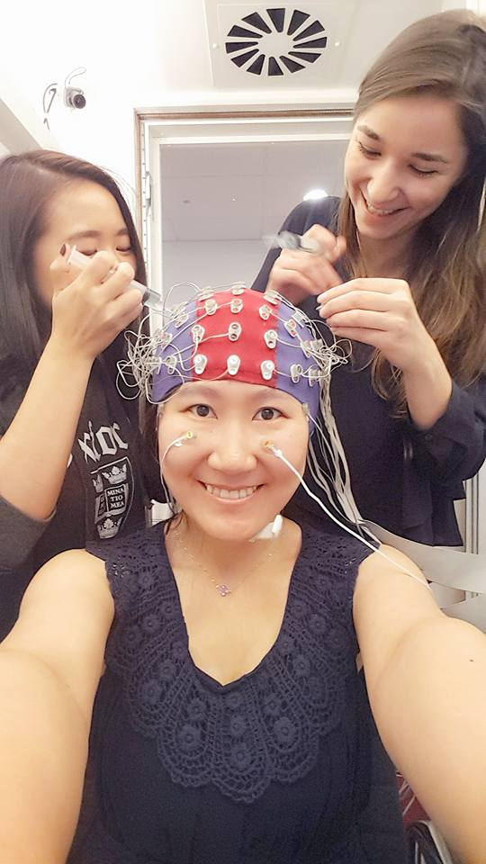


Slide 7
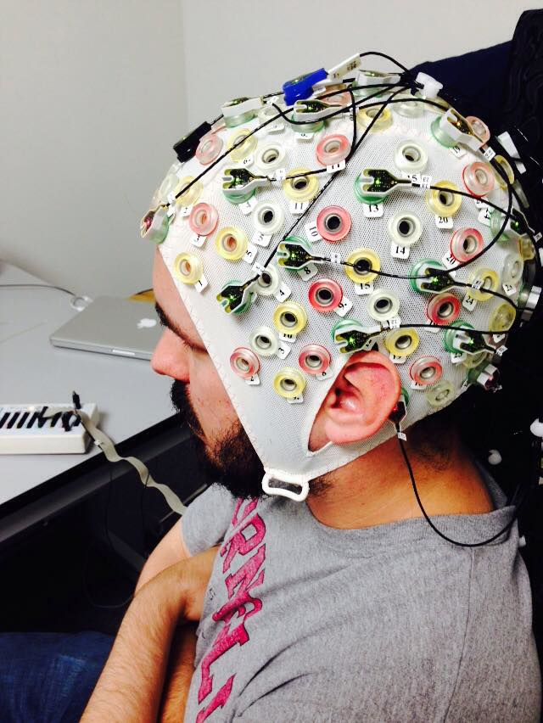
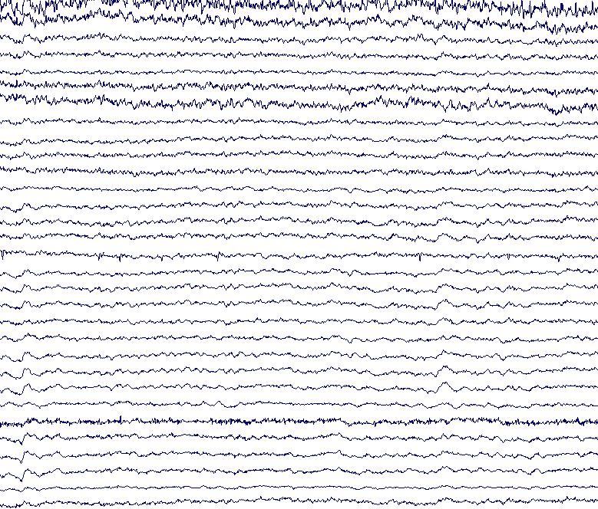
Electroencephalography (EEG)
Notes:
We’re gonna talk about how the brain processes Sis, so let’s talk about what EEG is

Slide 8
EEG vs. ERP
EEG (electroencephalography) --- the signal unfolding continuously
ERP (event-related potential) --- the signal lined up to a specific event in time (like hearing a word)

Slide 9
High-frequency word
Low-frequency word

Slide 10
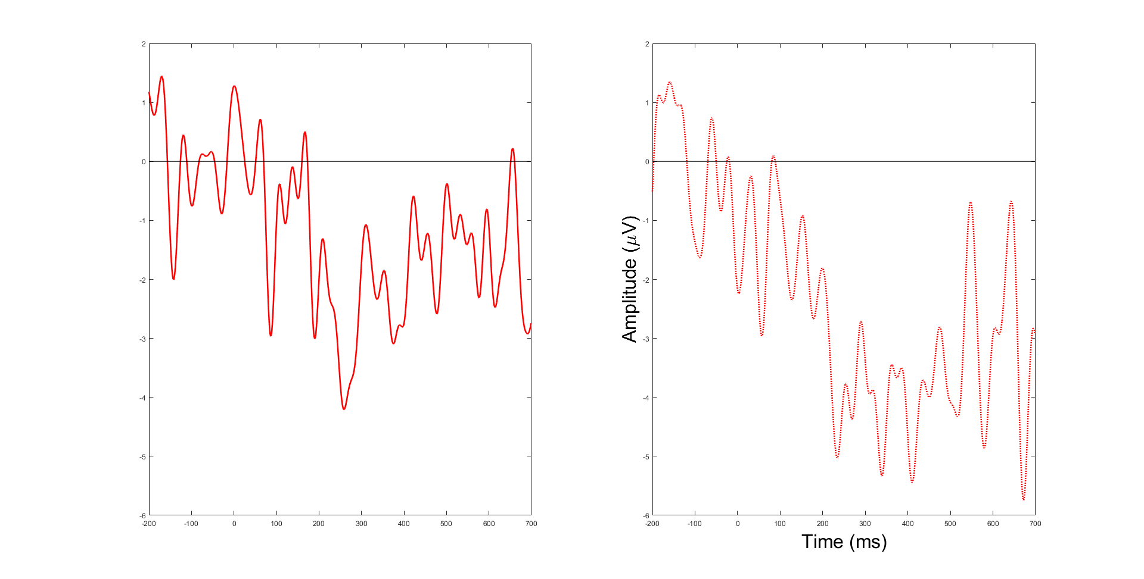
High-frequency word
Low-frequency word

Slide 11
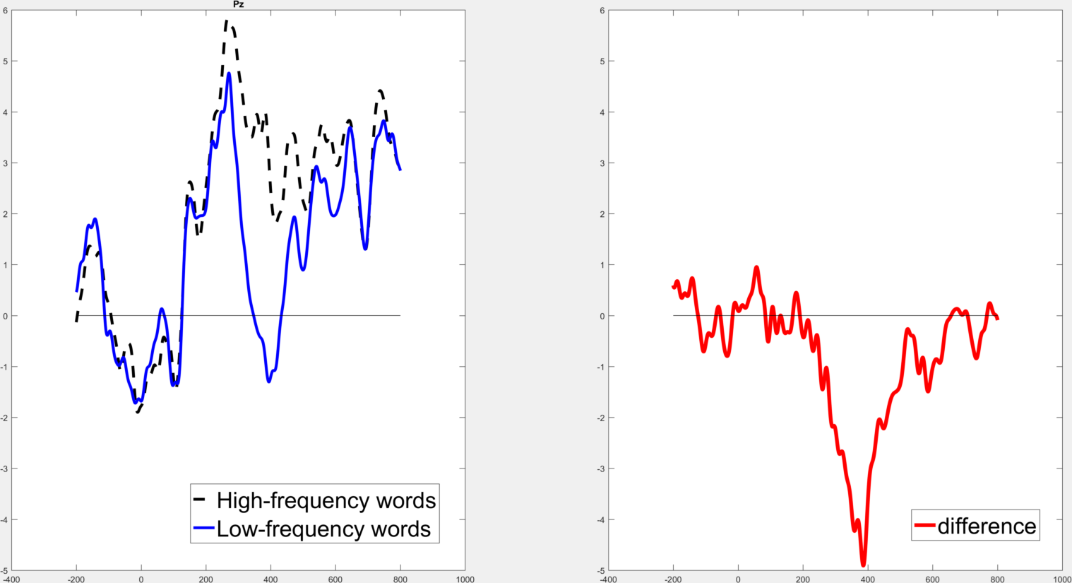

Slide 12
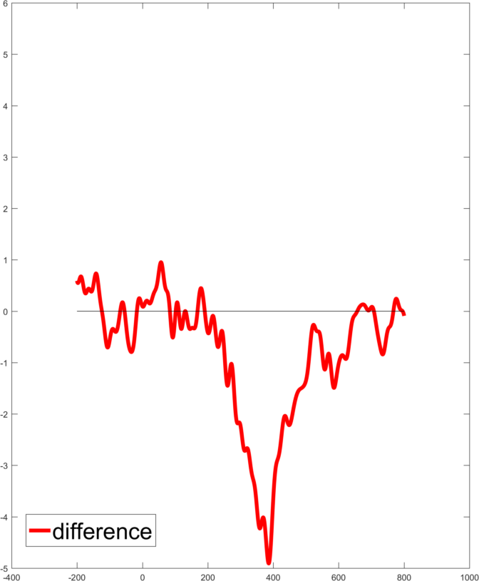
How to describe this wave?

Slide 13
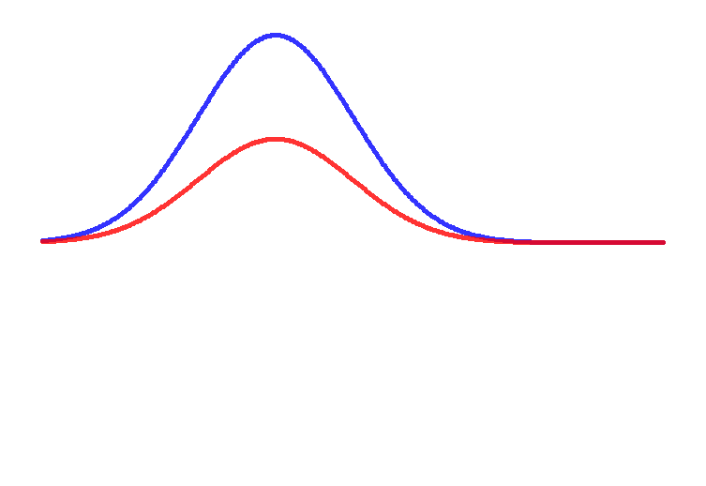
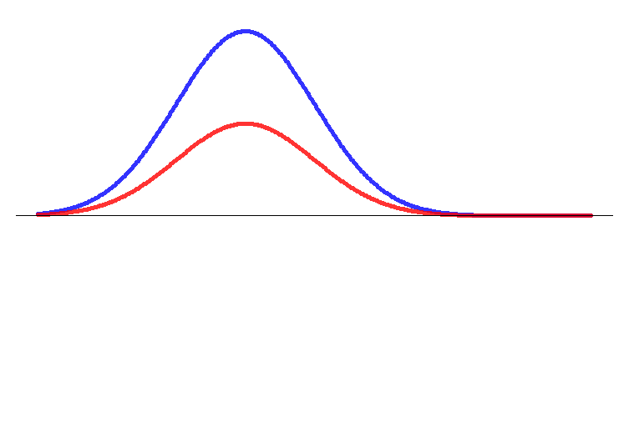
How do these waves differ?
Amplitude

Slide 14
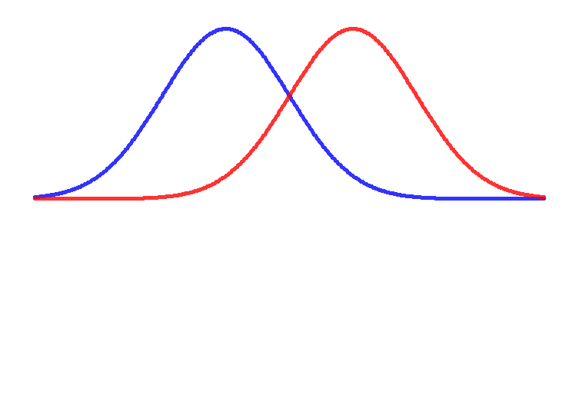
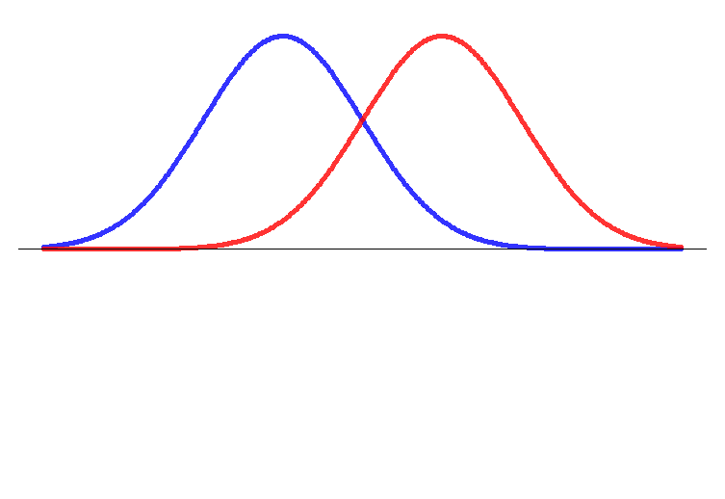
How do these waves differ?
Latency

Slide 15
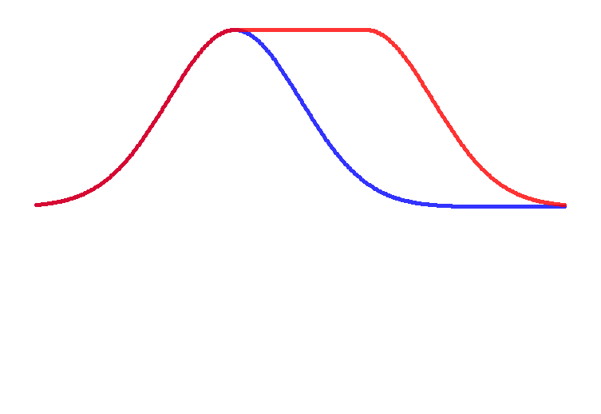
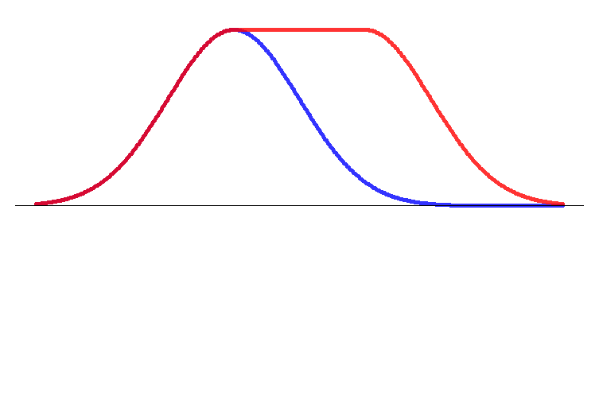
How do these waves differ?
Duration

Slide 16
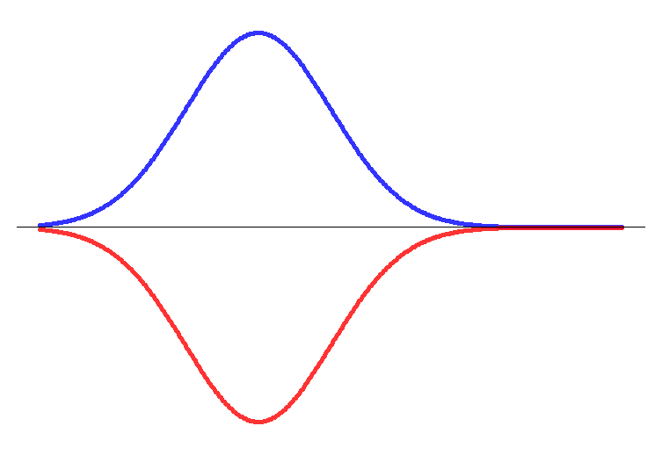
How do these waves differ?
-2 -1 0 1 2
Polarity

Slide 17
Duration
Polarity
Latency
Amplitude

Slide 18
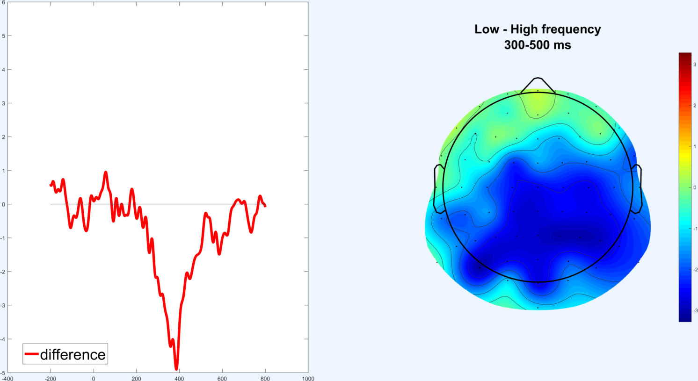
Pz
Topography

Slide 19
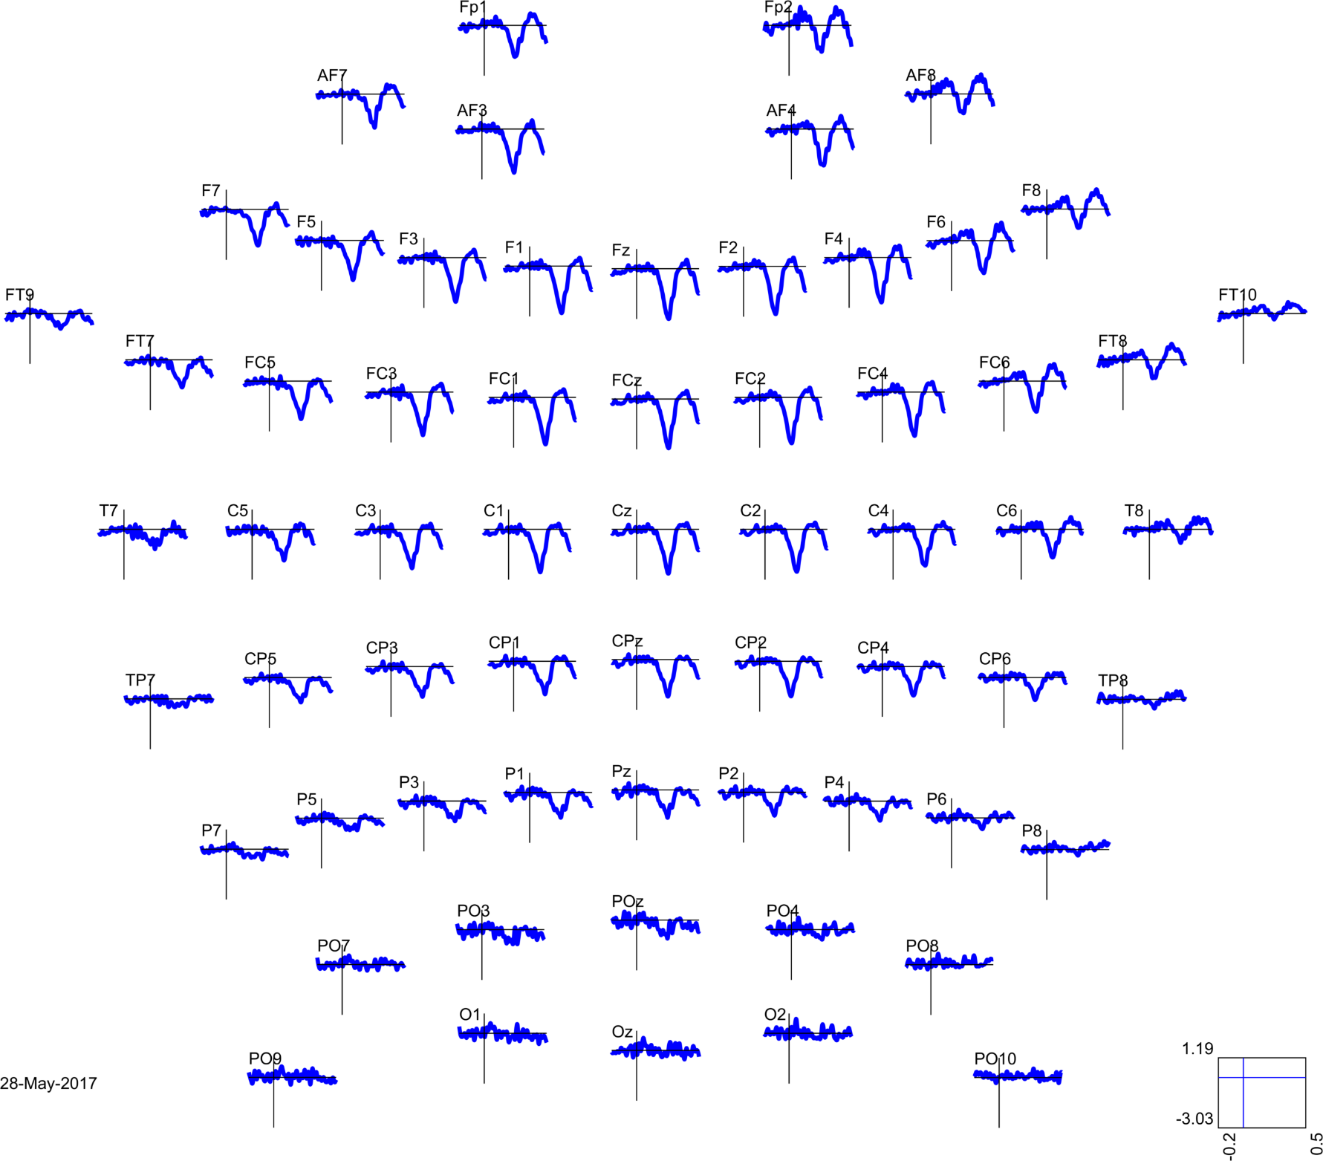

Slide 20
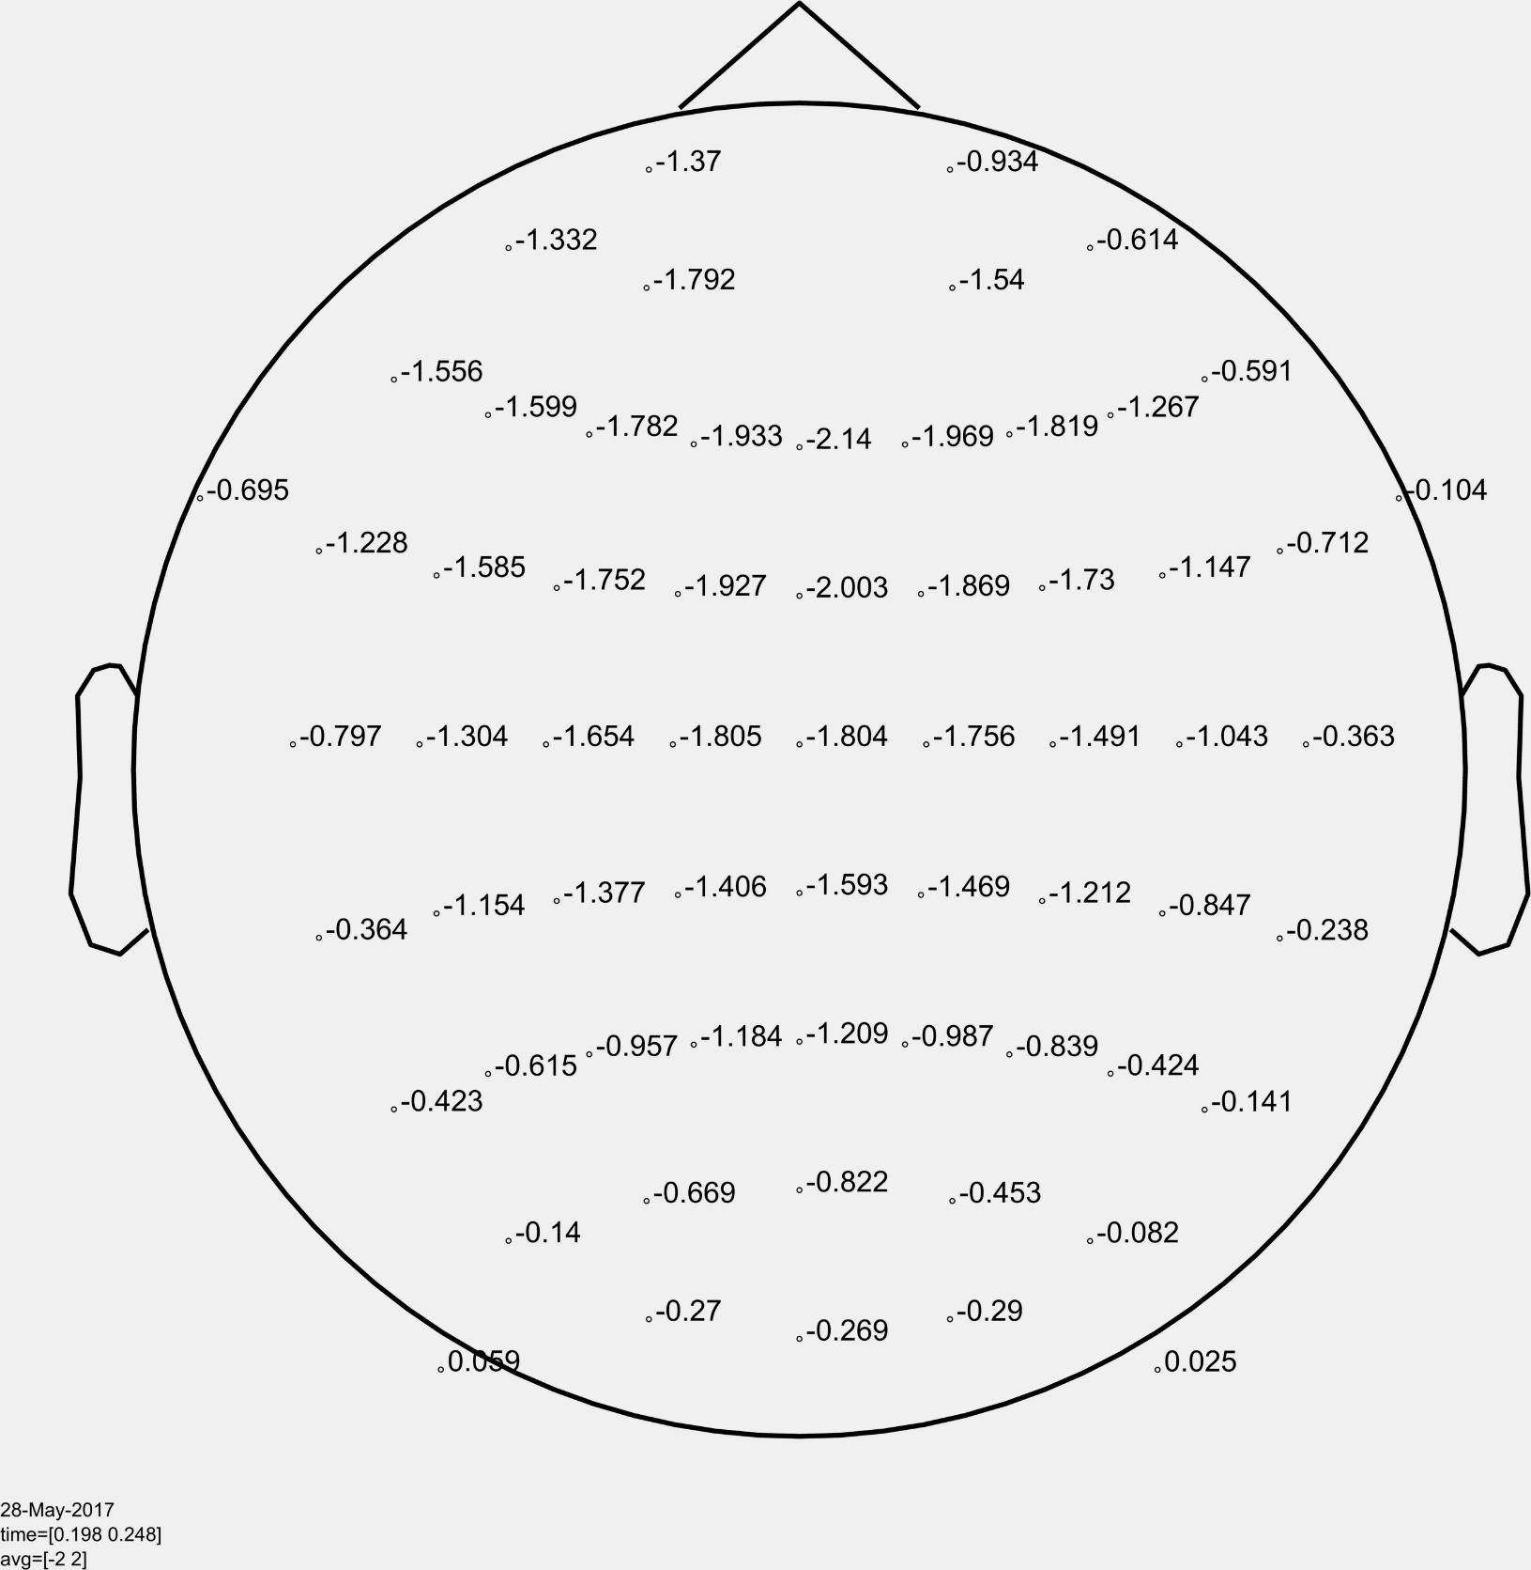

Slide 21
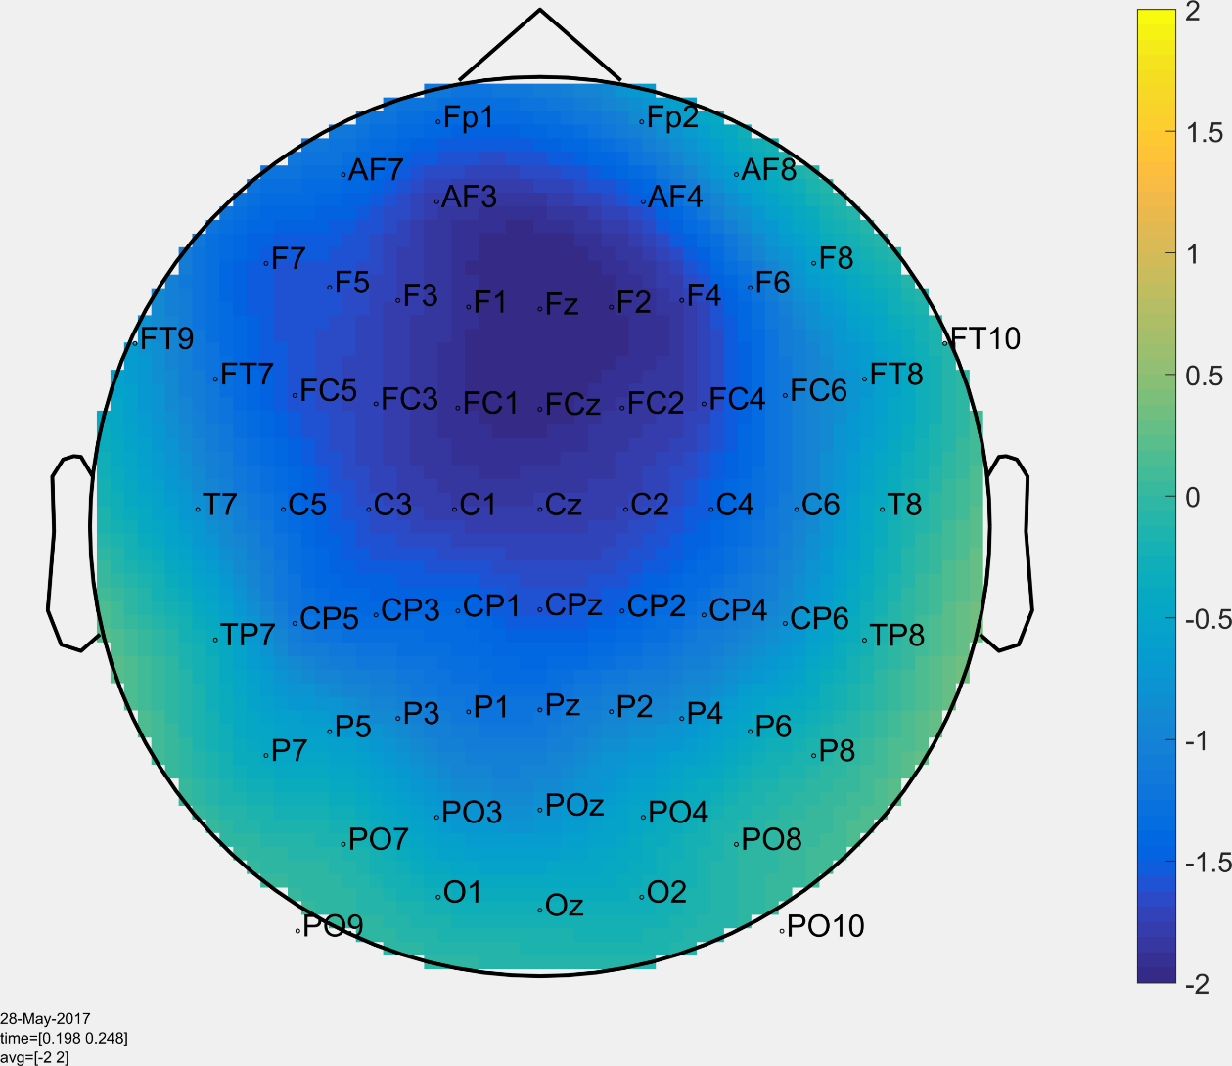

Slide 22
Pz
Topography

Slide 23
Features of an ERP
Polarity: positive or negative
Latency: when it appears
Amplitude: how big it is
Duration: how long it lasts
Topography: where on the head it appears

Slide 24
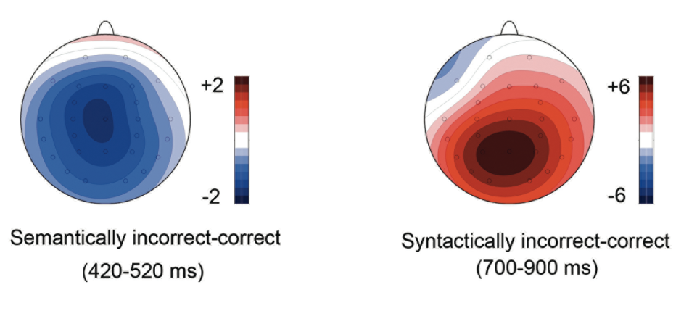
How do these components differ?
Figure from Schacht et al. (2014)
Notes:
For the first point: 1) answers to direct questions like that

Slide 25
Polarity
Figure from Schacht et al. (2014)
Notes:
For the first point: 1) answers to direct questions like that

Slide 26
Latency
Figure from Schacht et al. (2014)
Notes:
For the first point: 1) answers to direct questions like that

Slide 27
Amplitude
Figure from Schacht et al. (2014)
Notes:
For the first point: 1) answers to direct questions like that

Slide 28
Duration
Figure from Schacht et al. (2014)
Notes:
For the first point: 1) answers to direct questions like that

Slide 29
Topography
Figure from Schacht et al. (2014)
Notes:
For the first point: 1) answers to direct questions like that

Slide 30
The day was windy so the boy went outside to fly …
a kite (expected)
an airplane (unexpected)

Slide 31
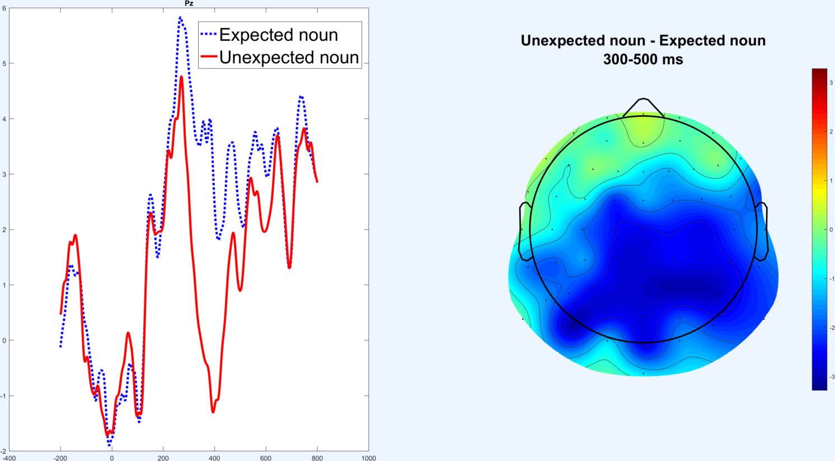
6
5
4
3
2
1
0
-1
-400
-200
0
200
400
600
800
1000

Slide 32
The day was windy so the boy went outside to fly …
a kite (grammatical)
an kite (ungrammatical)

Slide 33
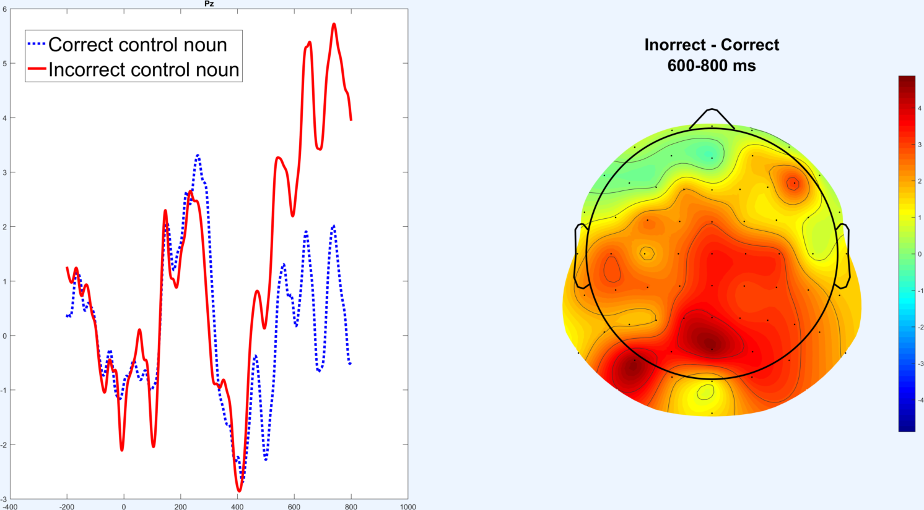
6
5
4
3
2
1
0
-1
-2
-400
-200
0
200
400
600
800
1000

Slide 34
The N400
I drink my coffee with cream and sugar.
I drink my coffee with cream and dog.
Amplitude (µV)
Time from onset of critical word (ms)
Figure adapted from Hunt, Politzer-Ahles, Gibson, Minai, & Fiorentino (2013)

Slide 35
Which method is more appropriate?
Is there masked priming for Chinese characters in the brain?
What part of the brain is activated when native English speakers here Chinese?
Do music and Chinese tones activate the same brain areas?
Does the brain treat classifier-noun mismatches (e.g. 三本裤子) as grammatical errors or meaning errors?

Slide 36
Use hemodynamic methods (like fMRI) when you care about where something happens
Use electrophysiological methods (like EEG) when you care about when and how something happens

